Slide 1
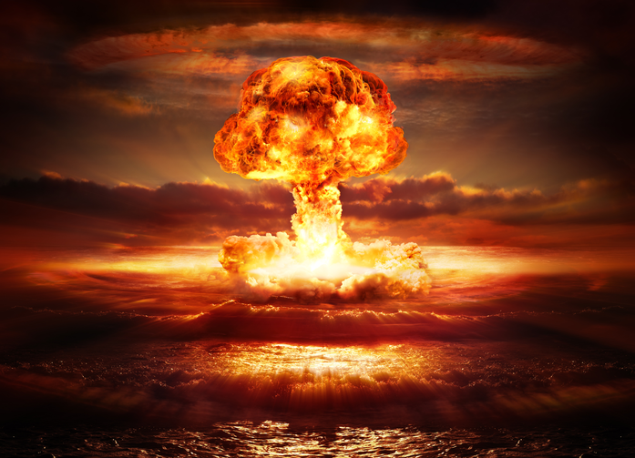
Where does the Church stand on nuclear weapons ?

Slide 2
US , first to make and use atomic weapons. . . . then lie about them
Hiroshima Aug 6th 1945
Nagasaki Aug. 9th
Notes:
Lies: 1. Destroying cities is O.K., Firebombing of Tokeyo city 2. We would have had to invade the home islands. 3. It was necessary to same American lives.
Thruths: 1. Japan was already surrendering. 2. We desired to demonstrate what the weapons could do. 3. We wished to scare the Russians.

Slide 3
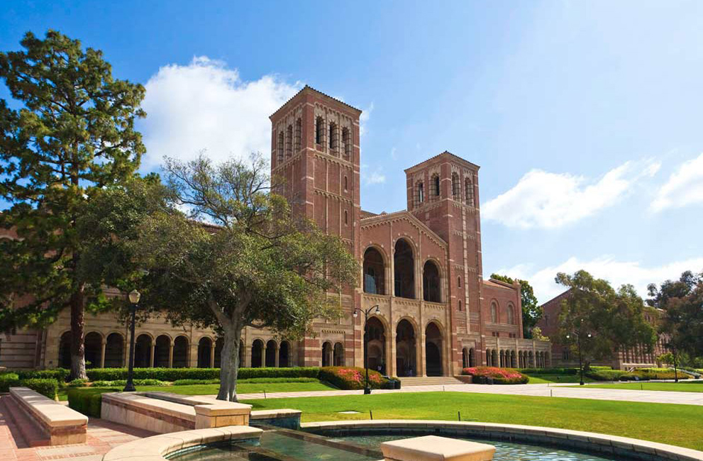
How we (Jim Rauner and his wife Elly) found the Bomb Elly’s pastor Aug 1945 Jim mid 1960’s after UCLA
Elly - at age 7 - the Sunday after Hiroshima and Nagasaki, at her Catholic Church in Burbank, California. Her pastor, Msgr. Keating, was at the pulpit. He was an ex-military chaplain, still connected to the Pentagon, and very patriotic. But today his face was red, and he looked angry, upset, and speaking loudly: she remembers hearing him say – “This is an abomination, an unforgiveable sin, and we will have to pay for this!”
Jim: I didn’t meet Elly until I was in college at UCLA, studying for a degree in Applied Physics. In June 1960, I graduated and immediately got a job, because we planned to marry that coming September.
Notes:
Elly at age 7, the Sunday after Hiroshima and Nagasaki, St. , the Catholic Church in Burbank, California. Her pastor, Msgr. Keating was at the pulpit, he was x-military chaplain, still connected to the Pentagon, very patriotic. But today his face was red, and he looked angry, upset, and speaking loudly: she remembers hearing him say – this is an abomination, an unforgiveable sin, that we will have to pay for this!
Jim: I didn’t meet Elly until I was in college at UCLA, studying for a degree in Applied Physics. In June 1960, I graduated and immediately got a job, because we planned to marry that coming September.

Slide 4
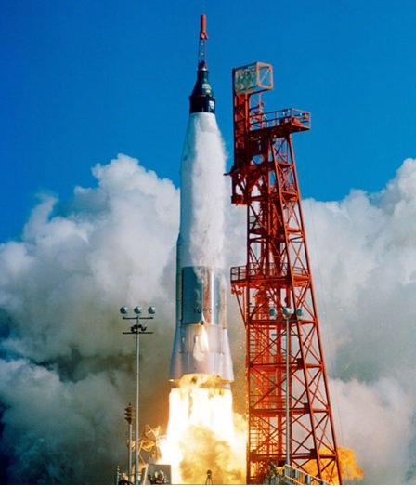
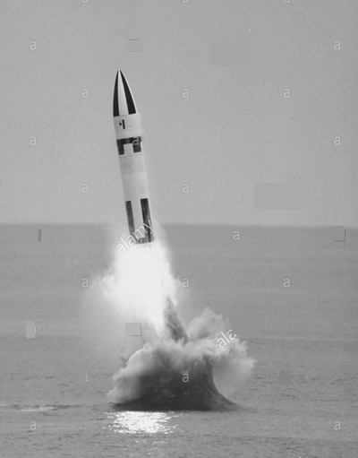
Jim’s Work - Early 1960’s
Atlas Rocket
Polaris missile
My first job was with Convair Astronautics, in San Diego. I was working on the flight control system on the Atlas rocket which was designed to launch satellites into orbit. We did get married in September and we had our first child a year later. It was easy to apply for better jobs in the industry, so I shopped around…
And obtained a job with Lockheed AeroSpace in Sunnyvale, California. This time I was working with the guidance control group for the Polaris Nuclear Missile fired from a submarine. After awhile I began to have troubles of conscience. Our accuracy at that time was only able to target something as big as a city. Later on , when accuracy improved, it didn’t matter anyway because the warheads would still destroy cities. I decided to leave the industry, and go back to school. Was accepted in the PhD program in Philosophy at the University of Notre Dame, so we packed up with our young son and a trailer loaded with belonging and moved to the Midwest.
Missiles are different than rockets, they kill people and cities.
Notes:
My first job was with Convair Astronautics, in San Diego. I was working on the flight control system on the Atlas rocket which was designed to launch satellites into orbit. We did get married in September and we had our first child a year latter. It was easy to apply for better jobs in the industry, so I shopped around…
And obtained a job with Lockheed AeroSpace in Sunnyvale, California. This time I was working with the guidance control group for the Polaris Nuclear Missile fired from a submarine.
After awhile I began to have troubles of conscience.Our accuracy at that time was only able to target something as big as a city. Later on , when accuracy improved it didn’t matter anyway because the warheads would still destroy cities, I decided to leave the industry, and go back to school. Was accepted in the PhD program in Philosophy at the University of Notre Dame, so we packed up with our young son and a trailor loaded with belonging and moved to the midwest.
Missiles are different than rockets, they kill people and cities.

Slide 5
Nuclear Nonproliferation TREATY, (NPT), 1970
The treaty included a two-part bargain: a majority of the world’s nations agreed not to acquire these weapons, in exchange for a pledge by the nuclear powers to end the arms race “at an early date and to negotiate the elimination of their nuclear arsenals.
The original treaty expired in 1995, nuclear States refusing to make it permanent, but pledging to at least not develop new nuclear weapons. They have all violated those pledges.
UN General Assembly in 2016 passed a resolution calling on nuclear nations to at least take nuclear missiles off high alert, … they have not done so.

Slide 6
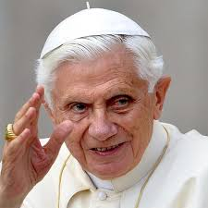
“In a Nuclear War there will be no victors, only victims.”
The truth of peace requires that all – whether states that openly or secretly possess nuclear arms, or those planning to do so – agree to change their course by clear and firm decisions, and strive for progressive nuclear disarmament.
Pope Benedict XVI

Slide 7
U.S Bishops Responded to the planned use of Nuclear Weapons
While the use of nuclear weapons was clearly immoral,
Pope John Paul II had said in a message to the U.N., in June 1982 that the system of deterrence could be judged “morally acceptable” as a “step on the way toward a progressive disarmament.”
May 3, 1983

Slide 8
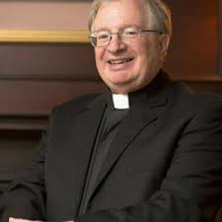
It is Naïve to Think that Deterrence had ever kept the peace
We have escaped nuclear holocaust many times by the skin of our teeth, from the miscalculations, accidents, and misunderstandings that repeatedly brought the world to the brink of a nuclear exchange.
Cuban missile crisis
32 “Broken Arrow” events
3 completely lost nuclear weapons
Explosion in an ICBM silo that ejected the warhead into a nearby field
2 hydrogen bombs dropped from damaged B52 over Goldsboro, N. Carolina. One armed itself and tried to fire, but one single switch failed.
Drew Christiansen, S. J.
Georgetown University
Notes:
Cuban missile crisis
32 “Broken Arrow” events
3 completely lost nuclear weapons
Explosion in an ICBM silo that eyected the warhead into a nearby field
@ hudrogen bombs dropped fro damaged B52 over Goldsboro, N. Carolina. One armed itself and tried to fire, but one single switch failed.
Ect… look for more on the internet.

Slide 9
Under Pope Francis, the church turns against nuclear deterrence.
The Pope has issued the church’s first unqualified condemnation not just of the use of nuclear weapons, which has long been deemed morally unacceptable, but now of their mere possession.
Following efforts of Pax Christi International and the Vatican,
Pope Francis statement on Nov. 10th ,2017
Notes:
Following efforts of Pax Christi International and the Vatican, Pope Francis statement on Nov. 10th ,2017

Slide 10
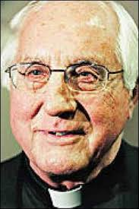
Gumbleton rejects U.S.Bishops’ earlier position on nuclear deterrence
It’s time that U.S. Catholic bishops now re-evaluate their 1983 pastoral letter, The Challenge of Peace, that offered a “strictly conditioned moral acceptance” of nuclear deterrence. . . in light of Pope Francis’ Nov. 10, 2017 statement that the “very possession” of nuclear weapons is to be “firmly condemned.”
Our own bishop Thomas Gumbleton, who helped draft the 1983 Pastor Letter
Notes:
Our own bishop Thomas Gumbleton, who helped draft the 1983 Pastor Letter

Slide 11
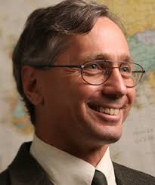
The Condemnation of Possession
The intent of the church’s very public support of the nuclear abolition movement is to rally the world’s Catholics around the issue.
Nuclear disarmament has not yet been on the radar of Bishops’ Conferences or of the Catholic Populations.
We in Michigan have an important and close resource of great strength at Notre Dame University. Certainly not on the radar of Michigan Bishops or Catholic populations !
Dr. Gerard Powers, director of Catholic Peacebuilding Studies, Notre Dame U.
Notes:
We in Michigan have an important and close resource of great strength at Notre Dame University. Certainly not on the radar of Michigan bishops or Catholic populations !

Slide 12
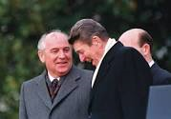
When Nuclear Winter
came to the attention
of Presidents Reagan &
Gorbachev, they took it
seriously.
Just previous to their meeting, Reagan had viewed the film, “The Day After,” and was very moved by it.
“A nuclear war cannot be won and must never be fought.” . . . . Subsequent agreements sharply reduced the number of nuclear weapons of both sides.
However with the end of the cold war and lowering tensions… nuclear winter dropped out of public consciousness.
Notes:
Just previous to their meeting, Reagan had viewed the film, “The Day After,” and was very moved by it.

Slide 13
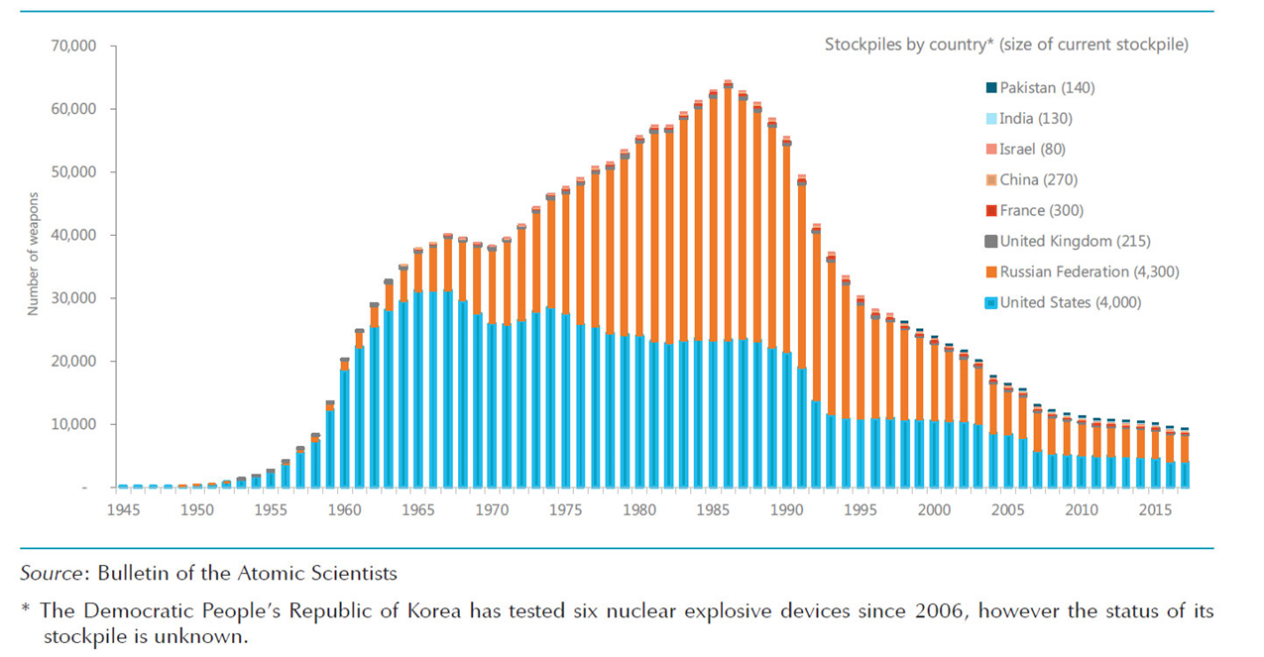
The maximum number of nuclear weapons reached a peak around 1986, and began to decline after the US – Russian agreement on weapons reduction.
To upgrade the present size of countries nuclear stockpiles, use recent issues of the Bulletin of Atomic Scientists
Notes:
The maximum number of nuclear weapons reached a peak around 1986, and began to decline after the US – Russian agreement on weapons reduction.
To upgrade the present size of countries nuclear stockpiles, use recent issues of the Bulletin of Atomic Scientists

Slide 14
Nuclear Winter!
In the early 1980’s, when the number of nuclear weapons in the world was approaching its Cold War peak of almost 70,000, scientific research began to reveal the climate effects which would result from the smoke which would be generated by nuclear fire- storms, when nuclear weapons were actually used.
Climate models have continued to indicate that smoke lingering in the atmosphere, and thus blocking sunlight, could cause drastic drops in temperature and severe disruption of world agriculture for up to years.

Slide 15
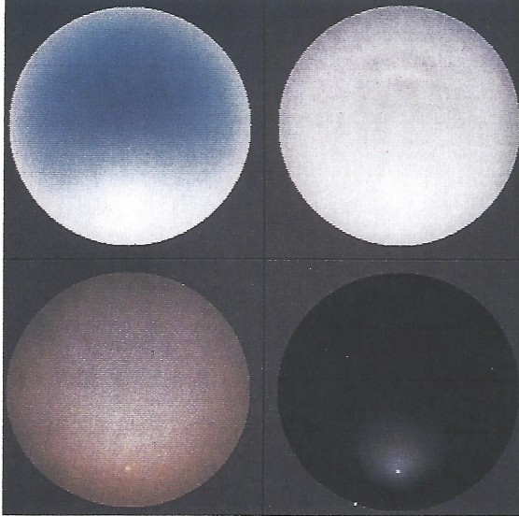
“A Path Where No Man Thought” by, Carl Sagan & Richard Turco, 1990
Representations of the sky with obscuration of different optical depths as if photo- graphed by an all-sky camera.
The Zenith is at the center of each circle, the horizon at the periphery.
Upper
Left - Normal Sky
Right – Cloudy Sky
Lower
Left – Sky with 20X normal
concentration of aerosols and
Particles (volcanic eruptions)
Right – Sky in Nuclear Winter

Slide 16
Prohibition of Nuclear Weapons Treaty 2017 122 of the world’s non-nuclear weapon states have adopted this treaty declaring that any use of these weapons would be abhorrent to the principles of humanity. All the nuclear powers boycotted the proceedings, and said they would ignore it. The Holy See signed and ratified it on the very day it was available.

Slide 17
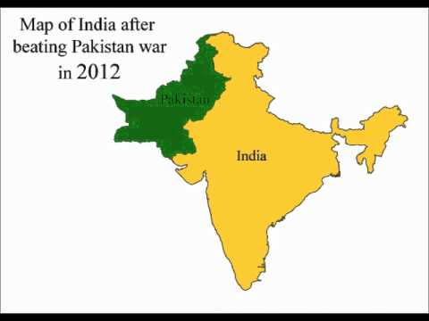
Even a Small nuclear exchange could cause global disaster
If India and Pakistan were to each use 50 Hiroshima-sized bombs, a very small fraction of one per cent of the world’s nuclear arsenal, the resulting climate impact on agriculture would put two billion people at risk of famine.
The world’s nuclear powers have simply ignored this information, and are modernizing their arsenals.
Reference early 2019 fighting between the two counties across their borders: earlier terrorist attack killing 40 Indian troops; Pakistan shooting down planes and capturing a pilot who were bombing a training camp within their country, etc. A situation that could have escalated into a nuclear war large enough to create nuclear winter.
Notes:
Reference early 2019 fighting between the two counties across their borders: earlier terrorist attack killing 40 Indian troops; Pakistan shooting down planes and capturing a pilot who were bombing a training camp within their country, etc. A situation that could have escalated into a nuclear war large enough to create nuclear winter.

Slide 18
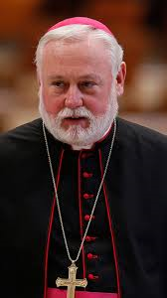
September 2018
Archbishop PaulGallagher, head of Vatican delegation to the United Nations
A
The Holy See supports the complete elimination of all nuclear weapons.
We affirm our common determination to create conditions and steps necessary for the total elimination of nuclear weapons from the world.
We must never resign ourselves to the idea that nuclear weapons are here to stay.

Slide 19
Improved Nuclear Risk Assessment
About a decade ago, ~2008, scientists, motivated by concern about nuclear risk, reopened the inquiry into the climate effects of nuclear war. This time the climate model and computer resources available had improved enormously since the 1980’s.
The results showed that the early concerns about nuclear winter had been greatly underestimated.
Any country initiating a nuclear war would literally be committing suicide.

Slide 20
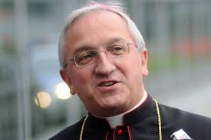
A war-fighting strategy using nuclear weapons has been put into place.
I worry especially over military thinking that focuses on the strategic potential of “small”, low-yield, “tactical” nuclear weapons.
Nuclear weapons are no longer just for deterrence but have become entrenched in the military doctrines of the major powers.
Archbishop Celestino Migliore
UN observer for the Holy See

Slide 21
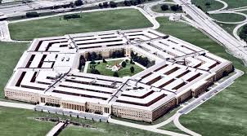
U.S. Nuclear Posture
Review 2018
A declassified summary of the nation’s nuclear strategy.
Development of smaller and more usable nuclear weapons to give the president more flexible options.
Lowering the threshold at which nuclear weapons might actually be used.
Opening the possibility of a nuclear response to a non-nuclear attack on military communications systems, or other attacks.

Slide 22
Nuclear States have backslided!
In Rome there is a well-founded concern that the United States and other nuclear powers have failed on disarming the world of nuclear weapons at the end of the Cold War – an historic missed opportunity. The Holy see has made the judgment that much more progress should have been made.
The Vatican is shaping an alternative vision of what is possible over the long term.
Gerard Powers, Kroc Institute,
Notre Dame University
We need to reach out to try to develop some ties between Pax Christi MI and the Kroc center at UND
Notes:
We need to reach out to try to develop some ties between Pax Christi MI and the Kroc center at UND

Slide 23
Nuclear Threat Grows as US withdraws from INF Treaty
The Intermediate-Range Nuclear Forces Treaty was signed by the US
and Russia in 1987.
It lead to the elimination of
nuclear and non-nuclear ground-launched ballistic and cruise missiles with range of ~300 to 400 mi.
Both countries have been
fudging on it,
But the US has now pulled out entirely, on Feb 2^{nd,} 2019.
So this takes the gloves off.
Now anything goes!
The ‘Doomsday Clock’ of the
Bulletin of the Atomic Scientists is
reading Two Minutes to Midnight, 2019.
Concerns go well beyond nuclear weapons:
Low-yield mini-nukes, precision- guided munitions, AI-enabled fully autonomous weapons, advanced cruise missiles, new missile defense systems, expanding into space and cyber domains
and hypersonic weapons.

Slide 24
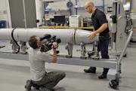
An Entirely New Nuclear Arms Race
The United States plans to commit more than $1 trillion over the next decade replacing and modernizing and improving the U.S. nuclear arsenal.
This is a blueprint for extending U.S. nuclear domination far into the future
Fleet of new B21 Raider strategic bombers
Dozen Columbia-class missile launching submarines
New ground based missiles to replace Minuteman III
ICBMs
New family of cruise missiles designed to penetrate
and survive advanced, integrated air defense

Slide 25
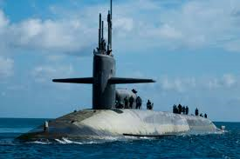
U.S. Nuclear TRIAD
Supersonic Bombers, B21’s. Flown recently over N. Korea as a threat.
ICBM fields – across half a dozen Midwestern States, with ~ 400 active silos.
Ohio class Nuclear Sub (we have 18), each could destroy an entire country, each carries 24 Trident III missile, with potentially 10 MIRV’d warheads each; Plus 150 cruise missiles, plus nuclear torpedoes. They are planning to load the new low-yield W76-2 warheads on some of the missiles.
Notes:
Supersonic Bombers, B21,s. Flown recently over N. Korea as a threat
ICBM fields – across half a dozen Midwestern States, with ~ 400 active silos.
Ohio class Nuclear Sub, we have 18, each could destroy an entire country, each carries 24 Trident III missile, with potentiallu 10 MIRV’dwarheads each;
Pluss 150 cruise missiles, plus nuclear torpedos
They are planning to load the new low-yield W76-2 warheads on some of the missiles.

Slide 26
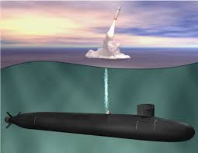
The new “modified’ nuclear warhead: The W76-2 “low-yield” version significantly lowers the threshold for nuclear war.
It is a 5 kiloton warhead, 1/3 the size of the Hiroshima bomb which killed 150,000 people.
It is not designed for deterrence, but for actual use. It will have a range of 7,500 miles.
It is rolling off the assembly lines now.
Notes:
It is a 5 kiloton warhead, 1/3 the size of the Hiroshima bomb which killed 150,000 people.
It is not designed for deterrence, but for actual use. It will have a range of 7,500 miles.
It is rolling off the assembly lines now.

Slide 27
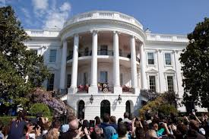
How to reach the American Government ?
During the waning days of the Obama administration, two arms control groups were able to get a meeting with White House staff, and urged that the President call attention to the nuclear winter findings in a major speech; the staff seemed receptive, but nothing came of it.
On one occasion several U.S. Senators sought to offer an amendment to the defense appropriations bill, calling for a study of the data by the National Academy of Sciences, but the Senate leadership said there was no room for the proposal on the Senate calendar.

Slide 28
What Pax Christi Michigan & USA Need to be doing right now about Nuclear War.
Organize a U.S. Peace Coalition.”
We are an unrecognized force in US politics. Our voice is utterly excluded from the inner circles of national security discussions.
2. Lobby the bishops’ conferences.
Until this imbalance is corrected, the spectrum of “legitimate opinion” will always tilt toward the military option.

Slide 29
Goals of a New Peace Movement Initial Steps
Abandon any First Strike Policy and Capability, No First Use. keep only a Second Strike Capability. Take all weapons off hair-trigger alert to prevent accidents.
Dismantle All land-based ICBM’s – the Minuteman IIIs.
They are sitting-ducks. Instead of upgrading them, save the money.
Reduce the SLBM Force to the level where it cannot destroy an entire country. Reasonable deterrence still preserved , but below the threshold for nuclear winter, perhaps 100 warheads or less.
Eliminate Launch-on-Warning, and place all nuclear weapons on de-alert.
5. End unchecked launch-authority of the President.
6. Work on Abolition Agreement among nuclear-armed states.

Slide 30
In Memorium – Dan Berrigan
"We have assumed the name of peacemakers, but we have been unwilling to pay any significant price for peace. We want peace with half a heart and half a life and half a will.
The war making continues because the waging of war is total, but the waging of peace is partial."
-- Daniel Berrigan
May he rest in eternal peace. Amen.

