Slide 1
Water Justice and Marginalized Populations
Stephen Gasteyer
Michigan State University

Slide 2
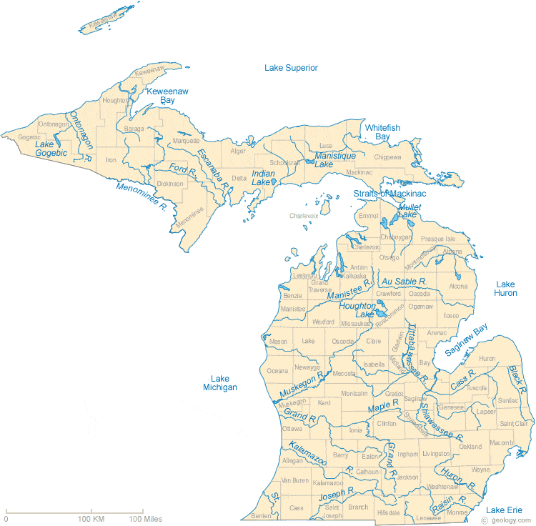
Water is Precious; We are Great Lakes people

Slide 3
Water can be a source OF Economic Life
Michigan Blue Economy
http://michiganblueeconomy.org/wp-content/uploads/2015/03/Michigan-Blue-Economy-Report.pdf
First peoples: Transportation, trade, fishing
Legacy Uses: Transportation, Ports, Shipping, Commercial Fishing
Big Water Users: Agriculture, Manufacturing, Energy, Beverages

Slide 4
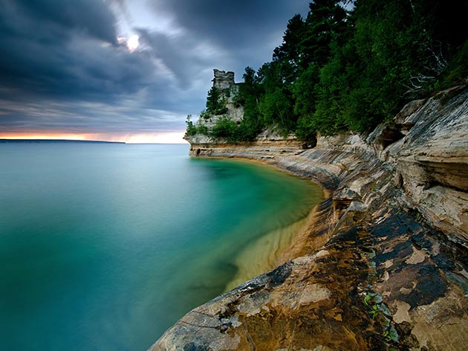
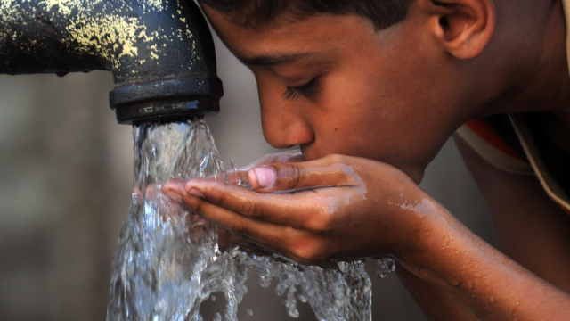
Water is Life – mni wiconi – in MichigaN

Slide 5
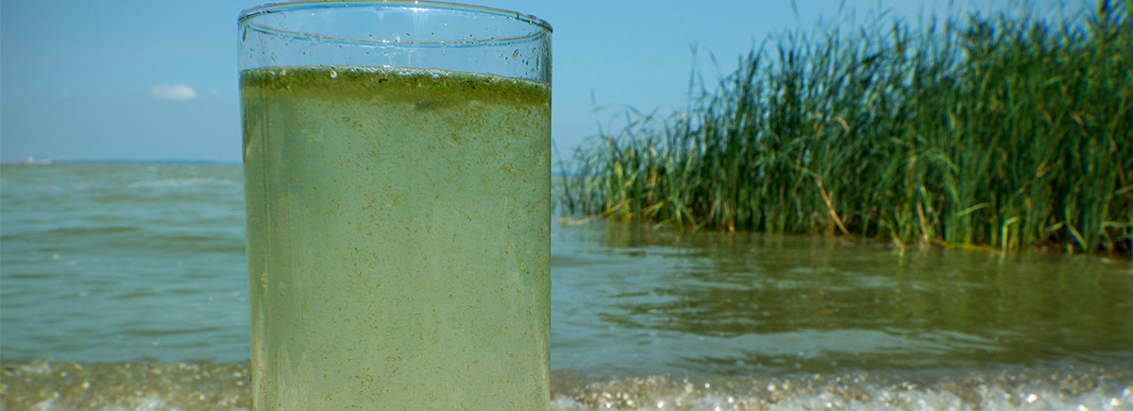
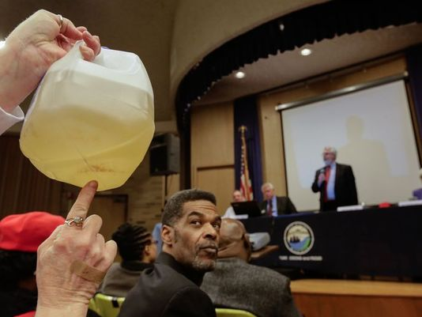
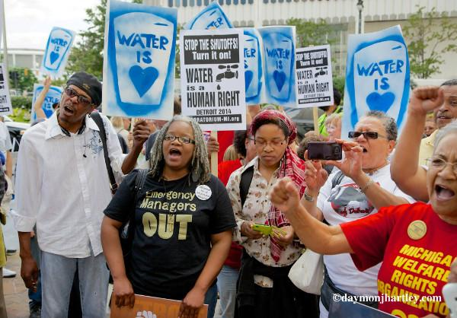
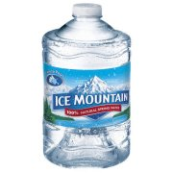
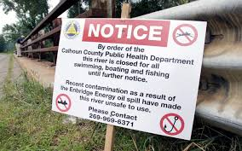
Water for All is under threat

Slide 6
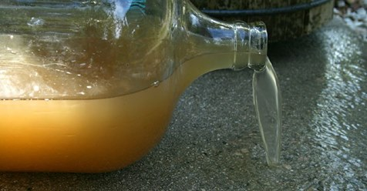
Water Justice issues -- Flint
Is the Flint Water Crisis Really Over? Residents and Experts Have Something to Say About It
http://atlantablackstar.com/2018/04/13/flint-water-crisis-really-residents-experts-something-say/
Flint – Decades of disinvestment – emergency management
2013/2014 Water Rates skyrocketed
Decision to switch from Detroit water and sewer to Flint River
2014 Lead corrosion and poisoning
State now declares water safe, ends water pods…
Cost of water people still can’t trust – up to $200 per month

Slide 7
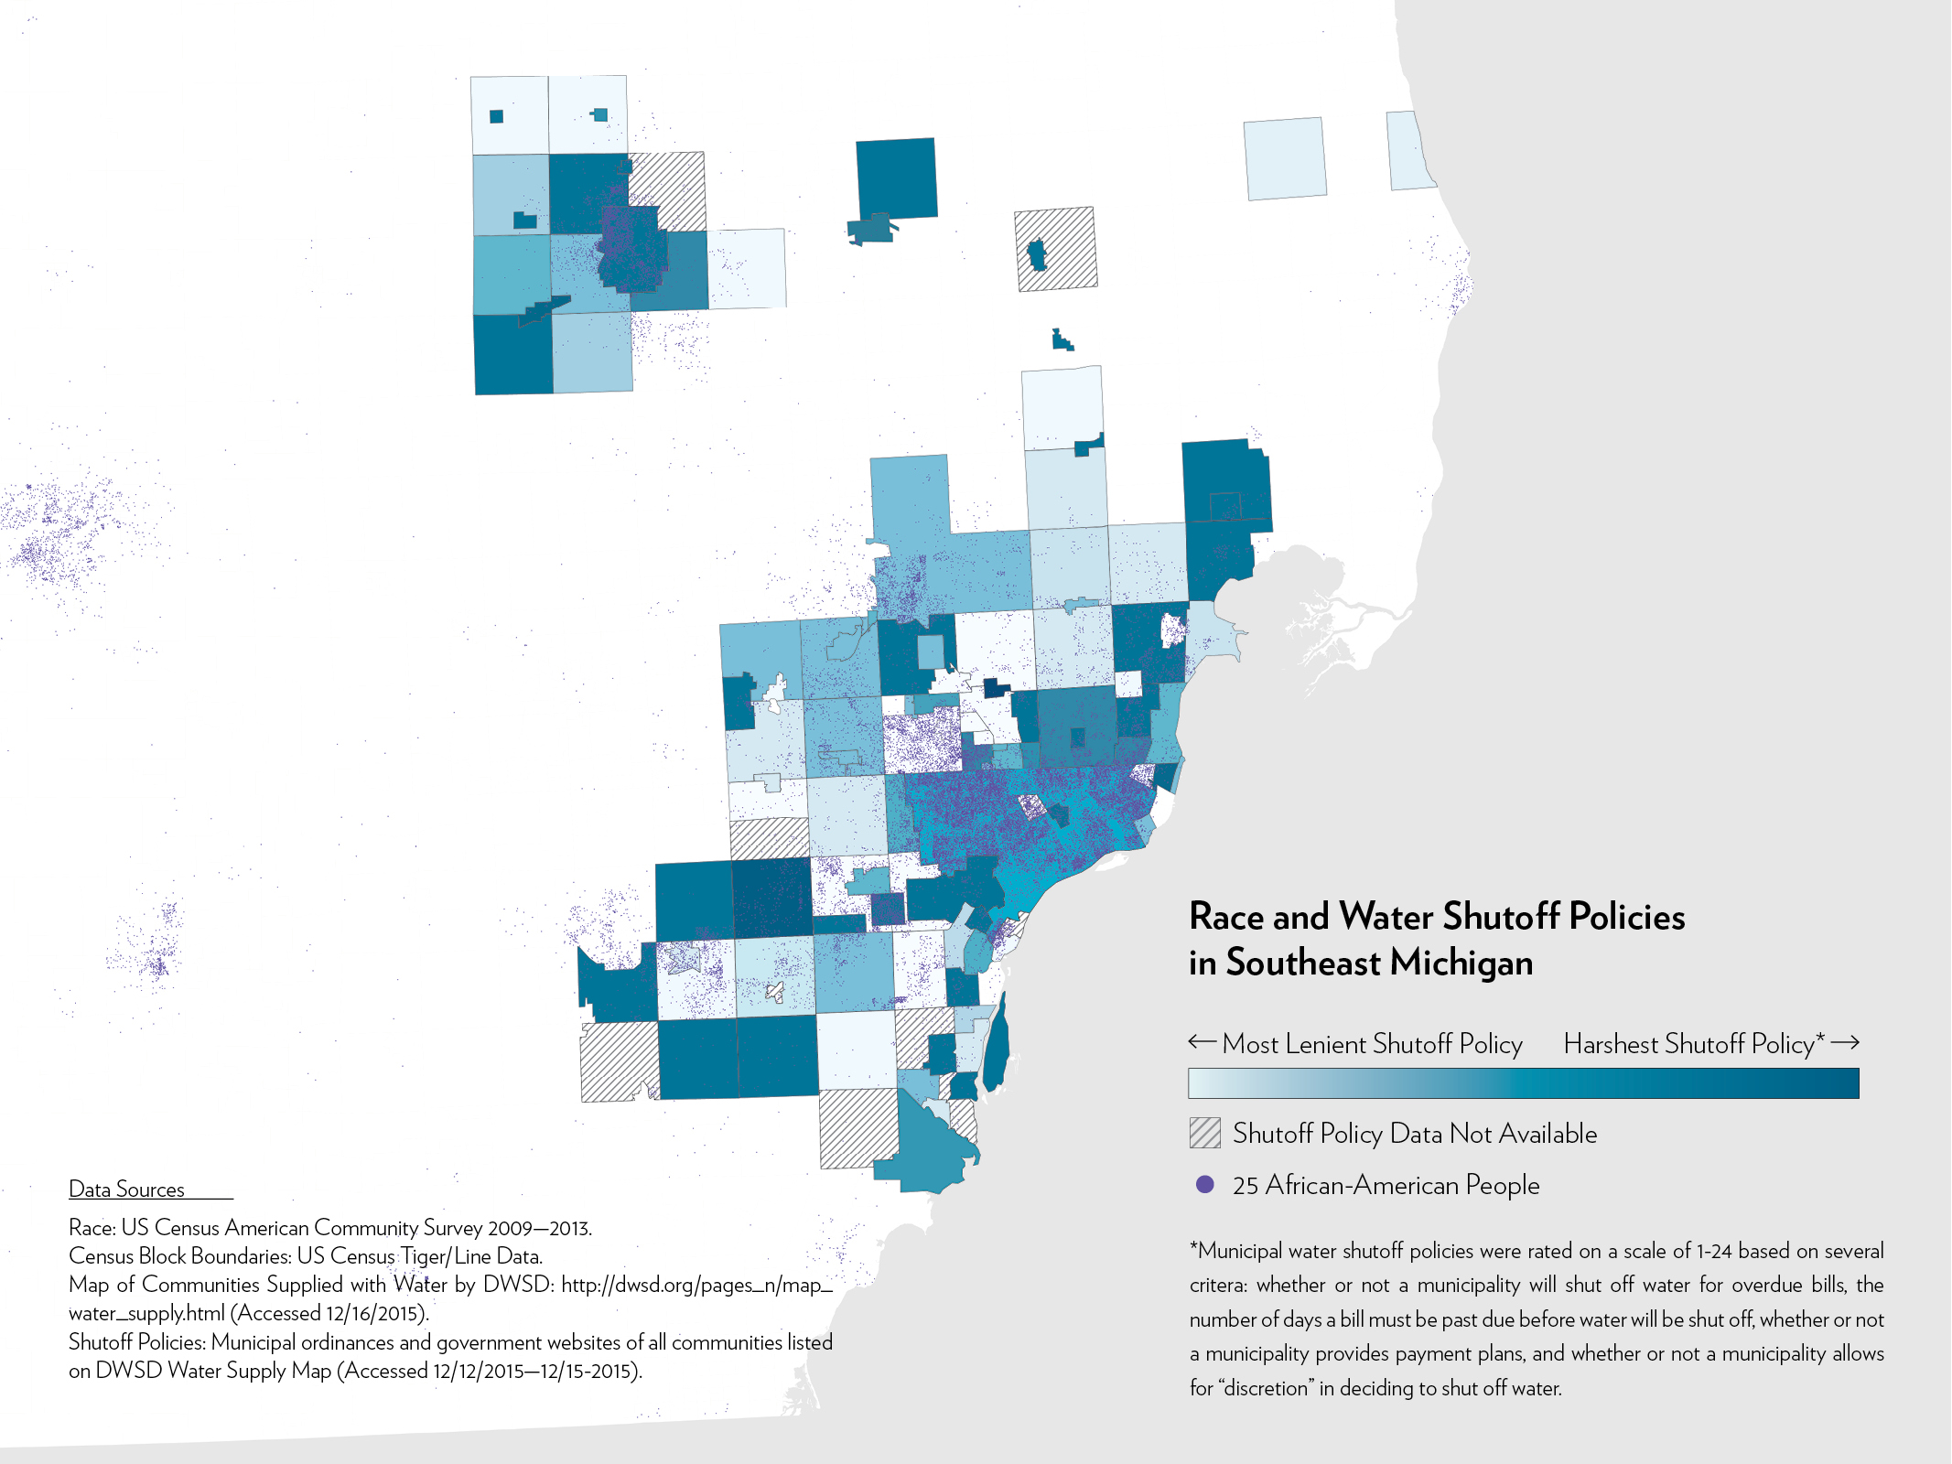
Detroit Water Shutoffs
Announcements that water shutoffs to resume in Detroit for non-payment
http://wethepeopleofdetroit.com/communityresearch/water/
2002 some 50,000 shutoff from water services
2012 continued shutoffs → to visit 2014 from UN special rapporteur on right to water and Sanitation
Leads to short term moratorium
Resumption of shutoffs to ask for compliance in rate payments…
http://wethepeopleofdetroit.com/communityresearch/water/

Slide 8
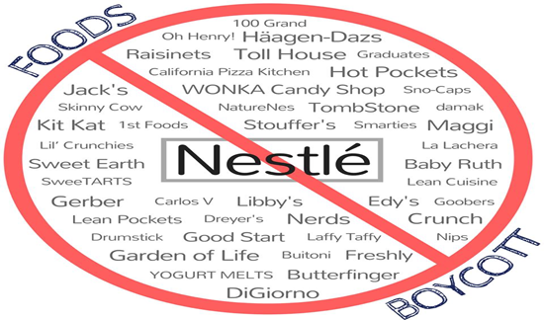
Action—Nestle
State recently approved nestle permit to pump 150 gallons per minute for water bottling
Of nearly 80,000 comments on the permit, only 70 were in favor, the vast majority were in opposition
Nestle will pay an administrative fee of $200 per year

Slide 9
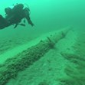
Threat of Line 5
https://www.oilandwaterdontmix.org/problem
Line 5 established in 1953 under Eisenhower Administration to ship oil across Mackinac Straights
Owned by Enbridge corporation which wants to increase shipping through line of Tar Sands oil
Evidence it is structurally unsound
Claims that the pipeline would be safe undermined by “anchor strike” that apparently damaged power cable line.

Slide 10
What we can do: Political Action
Calls and Emails.:
Governor Snyder: 517-373-3400 governorsoffice@michigan.gov
Ari Adler, Gov Spokesman: 517-335-6397 AdlerA@michigan.gov
MDEQ: Heidi Grether, Head: 517-284-6700, 517-284-6544 GretherH@michigan.gov
Tiffany Brown, MDEQ Spokesman: 517-242-1376 BrownT22@michigan.gov
Rich Baird: bairdr@michigan.gov
AG Schuette: 517-373-1110 miag@michigan.gov
Lt Gov Calley: 517-373-6800 brian.calley@michigan.gov.
These are contact numbers to call regarding Nestle
Shutting Down Line 5 which was damaged last week
Water Justice for Flint

Slide 11
What we can do: Political Action
Calls and Emails.:
Governor Snyder: 517-373-3400 governorsoffice@michigan.gov
Ari Adler, Gov Spokesman: 517-335-6397 AdlerA@michigan.gov
MDEQ: Heidi Grether, Head: 517-284-6700, 517-284-6544 GretherH@michigan.gov
Tiffany Brown, MDEQ Spokesman: 517-242-1376 BrownT22@michigan.gov
Rich Baird: bairdr@michigan.gov
AG Schuette: 517-373-1110 miag@michigan.gov
Lt Gov Calley: 517-373-6800 brian.calley@michigan.gov.
Dear __
I was deeply concerned that the Michigan department of environmental Quality approved the permit for the nestle corporation to pump bottled water from the Mecosta spring. This level of pumping could have significant ecological consequences. Further, it is deeply unpopular. Of the almost 80,000 comments, reports are that more 99% were opposed to the permit. I urge you to reconsider this permit.
Sincerely,

Slide 12
What can we do: Political action
Governor Snyder: 517-373-3400 governorsoffice@michigan.gov
Ari Adler, Gov Spokesman: 517-335-6397 AdlerA@michigan.gov
MDEQ: Heidi Grether, Head: 517-284-6700, 517-284-6544 GretherH@michigan.gov
Tiffany Brown, MDEQ Spokesman: 517-242-1376 BrownT22@michigan.gov
Rich Baird: bairdr@michigan.gov
AG Schuette: 517-373-1110 miag@michigan.gov
Lt Gov Calley: 517-373-6800 brian.calley@michigan.gov
Shutting Down Line 5 which was damaged last week
Dear __
I am increasingly concerned that Enbridge line 5, which ships oil across the straits of Mackinac poses a danger to our water and ecological integrity. Just this last week, the line was reportedly damaged. Should the line break, we understand that the damage to the ecological integrity of the great Lakes would be catastrophic as a spill would be extremely difficult to contain. Please take the step that is most prudent and shut down line 5.
Sincerely,

Slide 13
What can we do: Political action
Governor Snyder: 517-373-3400 governorsoffice@michigan.gov
Ari Adler, Gov Spokesman: 517-335-6397 AdlerA@michigan.gov
MDEQ: Heidi Grether, Head: 517-284-6700, 517-284-6544 GretherH@michigan.gov
Tiffany Brown, MDEQ Spokesman: 517-242-1376 BrownT22@michigan.gov
Rich Baird: bairdr@michigan.gov
AG Schuette: 517-373-1110 miag@michigan.gov
Lt Gov Calley: 517-373-6800 brian.calley@michigan.gov
Justice for Flint, Michigan
Dear __
The people of flint, Michigan have been traumatized and harmed by the water crisis. I am calling on you to reverse the decision to end distribution of alternative water sources. There are good reasons to remain deeply suspicious of the water that is coming out of the taps in flint. Please let the people of flint guide your decision on next steps in addressing this ongoing crisis.
Sincerely,

Slide 14
What we can do—economic boycott
At least boycott nestle bottled water
You could generally advocate against bottled water
But could also generally boycott nestle and let people know

Slide 15
What we can do—Political Action
Joining protests
The Detroit Light Brigade has an event tomorrow as part of the Boycott Nestle campaign
April 14 -- 8:30-10:00
2 Jefferson Ave East, Detroit, Michigan 48226

Slide 16
Action – support action organizations
Organizations
Michigan Water protectors
  Lakeshore water protectors
    Shannon donley
Oil and water don’t mix
We the people Detroit
Detroit Welfare Rights
Detroit Light Brigade
The People’s Water Board Coalition

